Slide 1

Airline Customer Booking Analysis
A comprehensive analysis of booking behavior and recommendations to improve booking completion rates.
Pitch
Anthony Ofordum

Slide 2

Agenda
Introduction
Overview
Problem Statement
Data Process
Methodology
Key Insights
Recommendations
Conclusion & Next Steps
About

Slide 3
introduction
Objective: To analyze booking behavior, identify factors influencing booking completion rates, and provide recommendations to optimize airline operations and increase revenue.
Data: The dataset consists of 50,000 bookings with 7,000 completed bookings, 43,000 non-completed bookings, and a 15% overall completion rate.

Slide 4
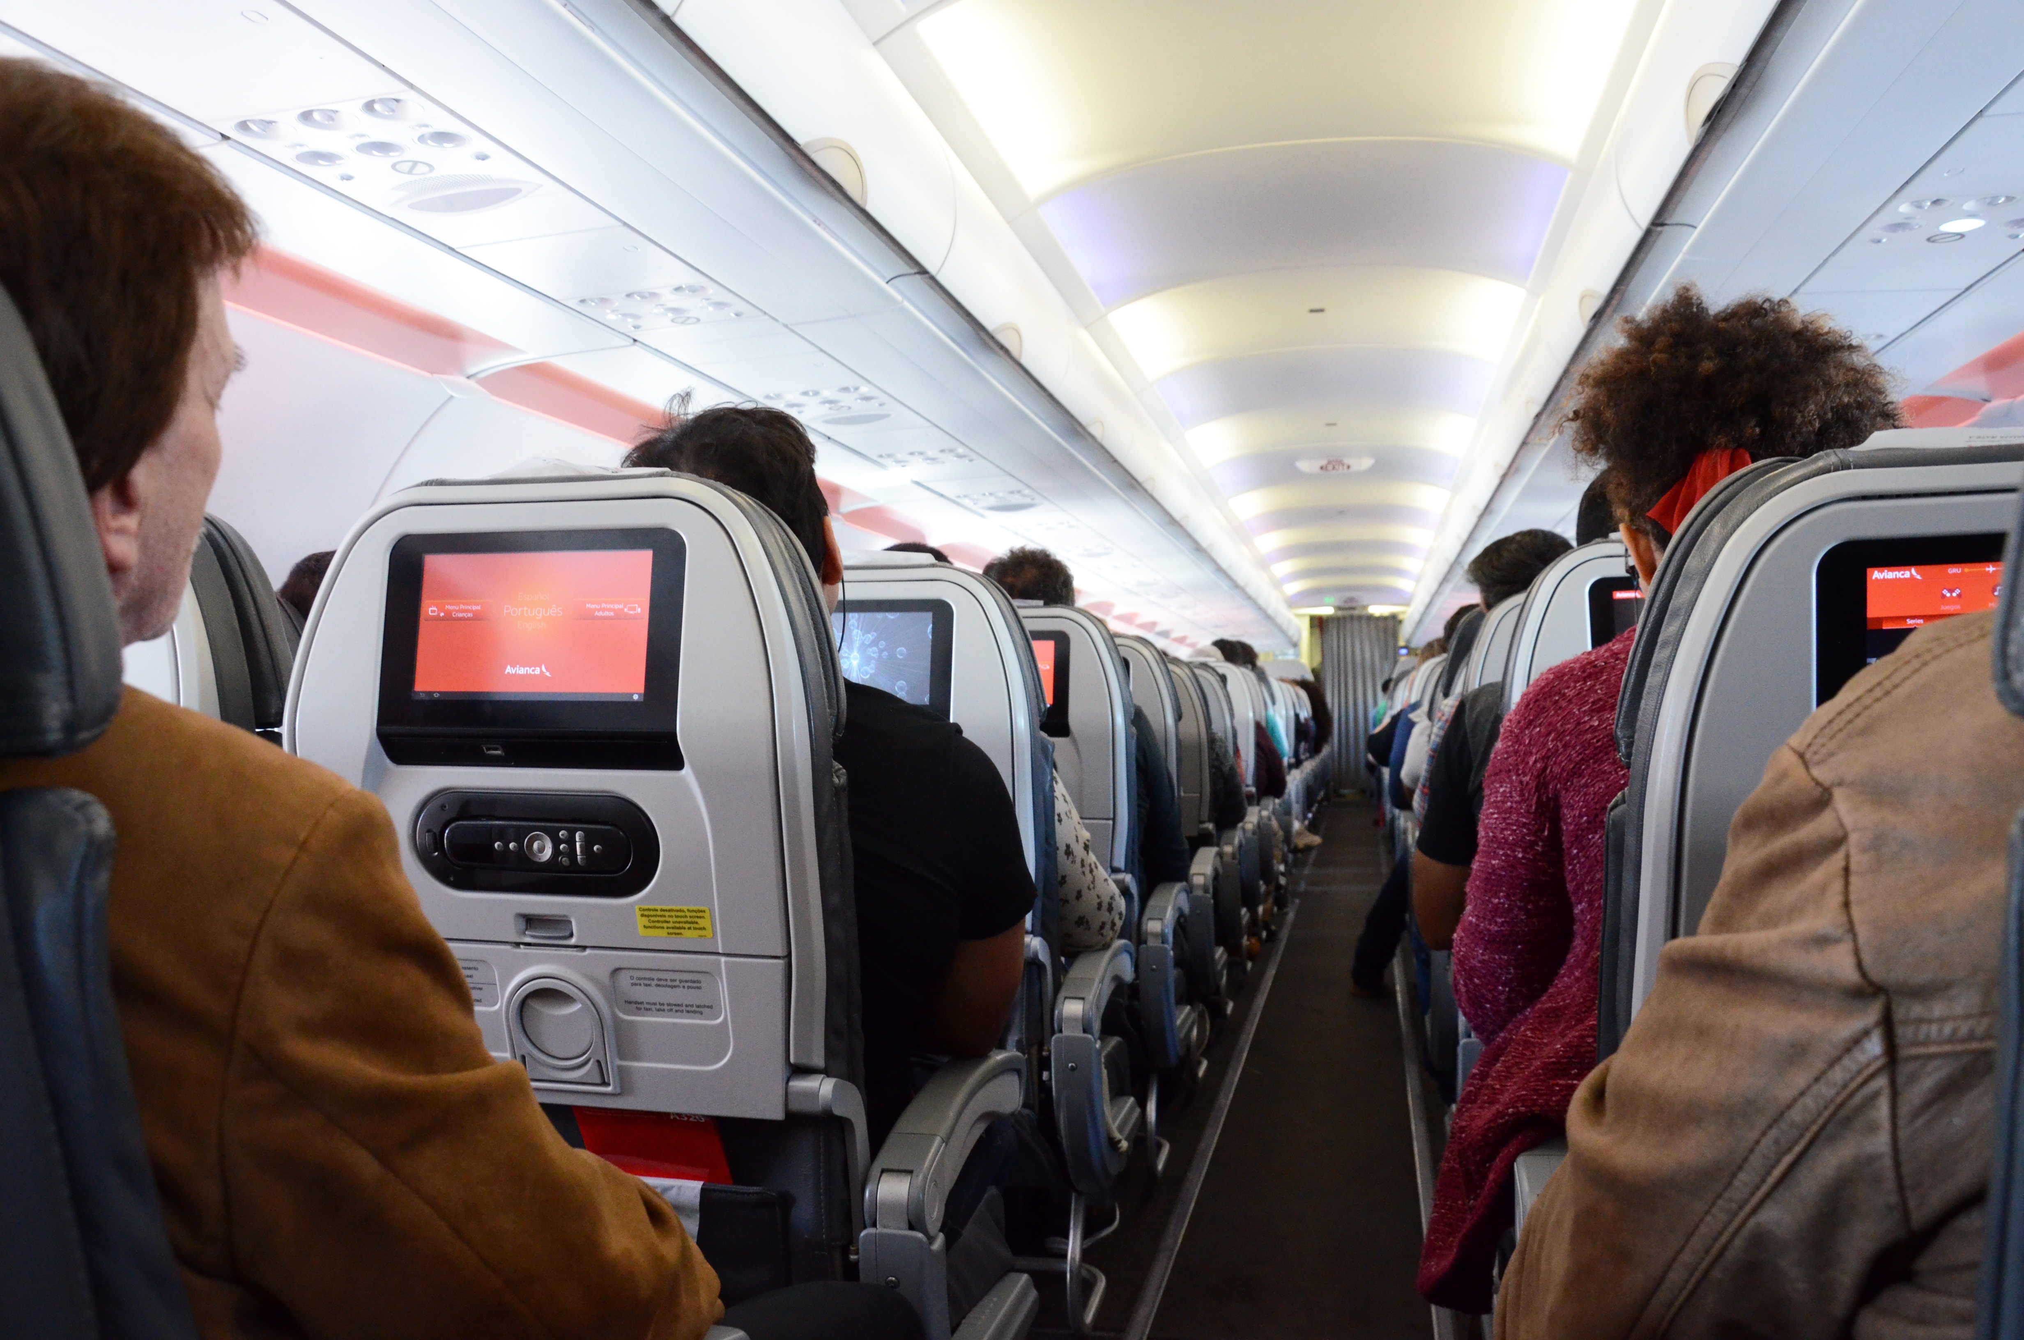
Problem statement
The airline faces a low booking completion rate of 15%, indicating that a large portion of customers are not completing their bookings.
The goal is to: Identify key factors that lead to booking completion.
Provide actionable insights to improve customer engagement and increase completed bookings.

Slide 5

Data process
Data gathering
Sourced dataset detailing booking completion status, lead time (time between booking and flight), sales channel, customer preferences, and length of stay.
Data transformation
Categorization of data for analysis
Business
Data visualization
Used Power BI to create interactive dashboards showing booking patterns, completion rates, and customer preferences.

Slide 6

methodology
Tools Used: Power BI for data analysis and visualization.
Key Metrics Analyzed:
Booking completion rates by lead time, flight time, sales channels, service preferences, and length of stay.
Data Sources: Customer booking data (50,000 records).

Slide 7

Key Insights
Lead Time: Bookings made within 1 week of the flight have the highest completion rate (17%).
Length of Stay: Longer stays (more than 1 year) show a 26% completion rate, while shorter stays (1 week or less) still have a solid 19% completion rate.

Slide 8
Key Insights
Sales Channel: Internet is the dominant channel with 91.86% of completed bookings, compared to Mobile at 8.14%.
Flight Time: Morning flights (6:00 AM to 11:59 AM) have the highest total bookings (18.7K), while evening flights (6:00 PM to 11:59 PM) have the lowest completion rates.

Slide 9
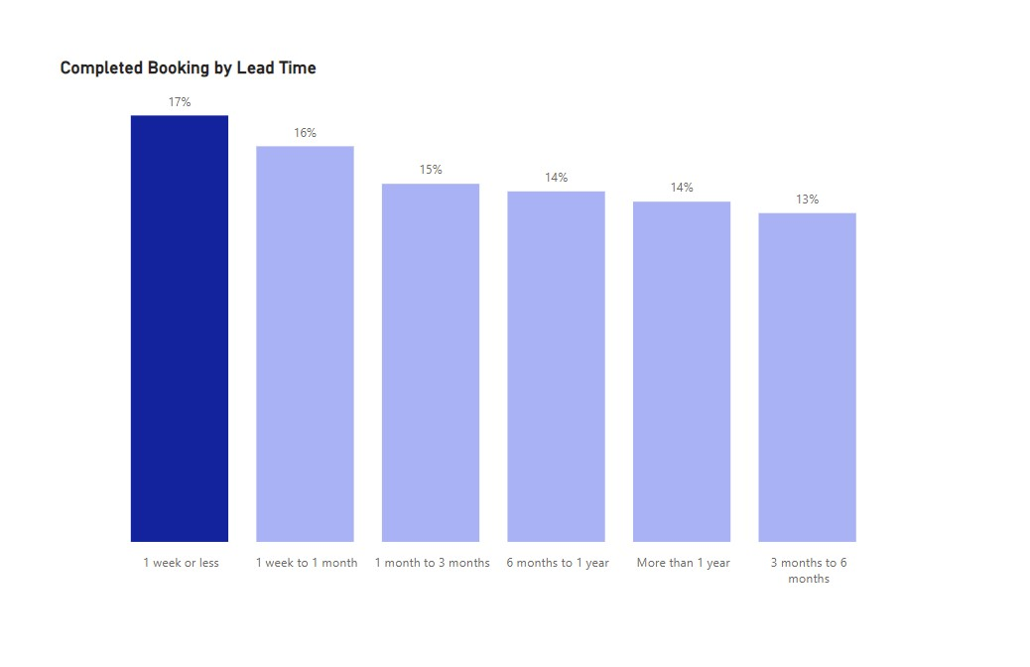
Key Insights
Bookings made within 1 week of the flight have the highest completion rate of 17%, suggesting that focusing on last-minute marketing campaigns could help capture more high-conversion bookings.

Slide 10
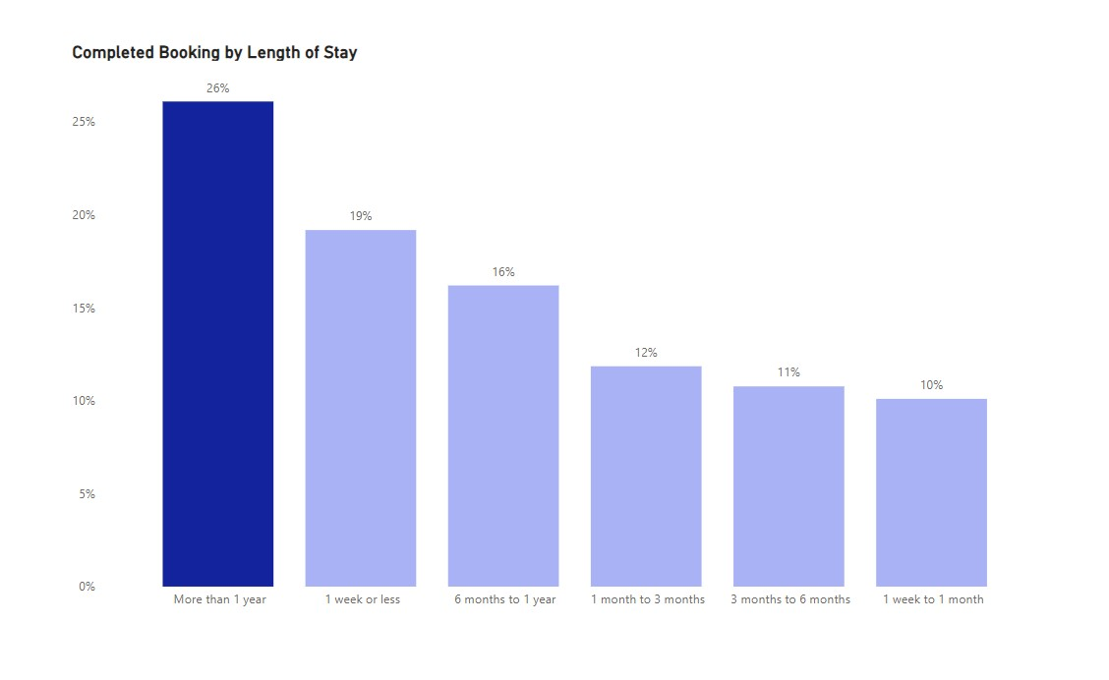
Key Insights
Longer stays (more than 1 year) show a 26% completion rate, while shorter stays (1 week or less) maintain a solid 19%, indicating that promoting extended stay packages and short-trip deals could effectively boost both segments.

Slide 11
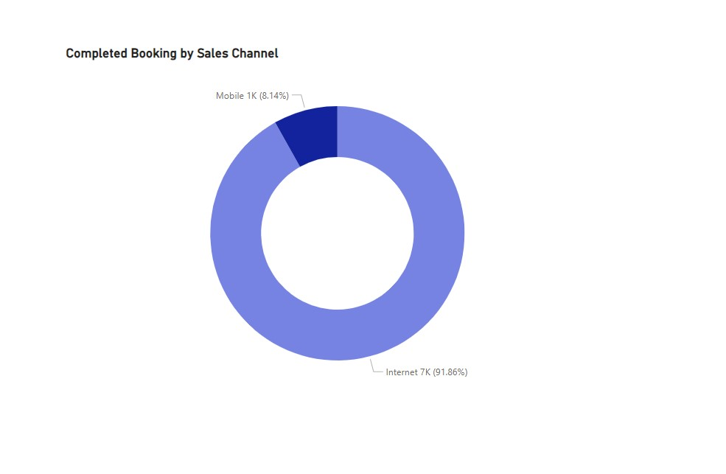
Key Insights
Internet bookings account for 91.86% of completed bookings, while Mobile trails at 8.14%, suggesting that improving the mobile experience could help capture more mobile customers.

Slide 12
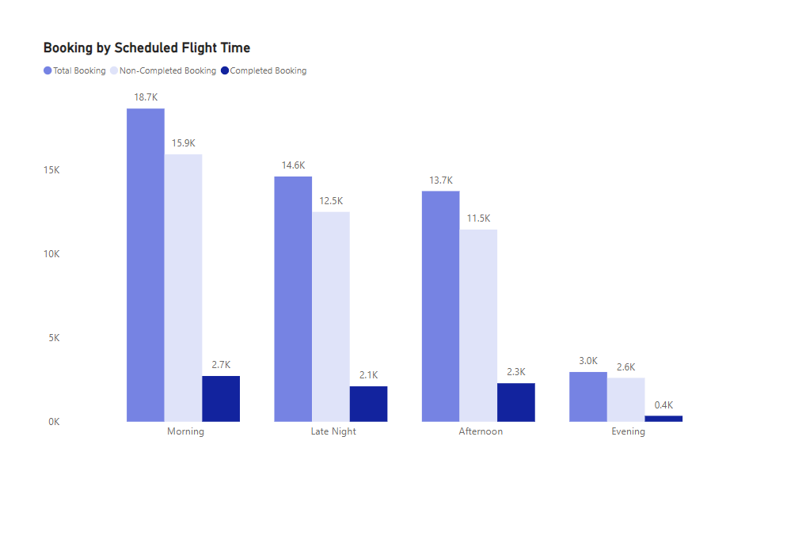
Key Insights
Morning flights (6:00 AM to 11:59 AM) see the highest booking volume, while evening flights struggle with low completion rates, indicating an opportunity to increase morning flight capacity while offering discounts for evening flights to improve overall booking performance.

Slide 13
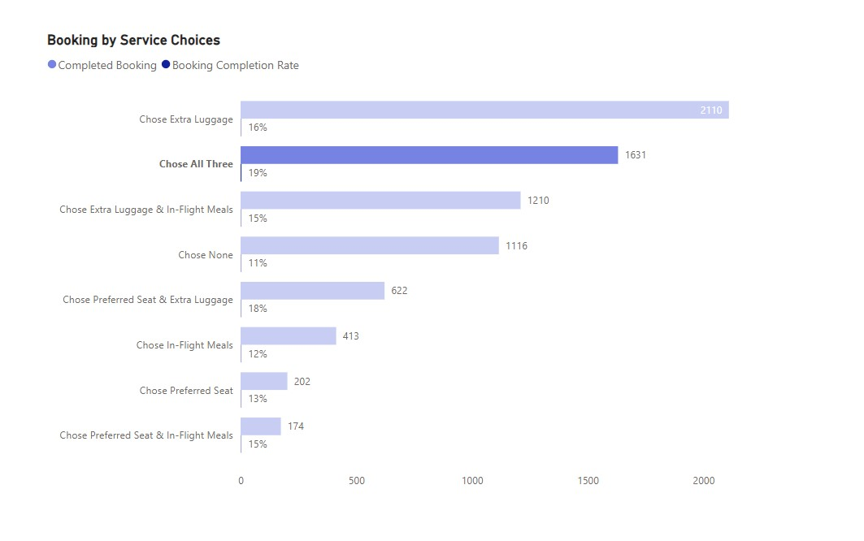
Key Insights
Customers who select all three services (extra luggage, seat, meals) have the highest completion rate at 19%, compared to 11% for those who select none, suggesting that offering bundled service packages could encourage higher commitment and booking completions.

Slide 14
recommendation
Target Last-Minute Bookers: Run last-minute booking campaigns for customers booking flights within 1 week to capitalize on their high completion rate (17%).
Optimize Mobile Experience: Improve the mobile app or mobile website experience to increase mobile bookings, which currently make up only 8.14% of completed bookings.
Incentivize Service Add-ons: Promote service bundles like extra luggage, preferred seats, and in-flight meals to increase booking completion rates.
Optimize Flight Schedules: Offer discounts or promotions for less popular flight times, especially evening and late-night flights.

Slide 15
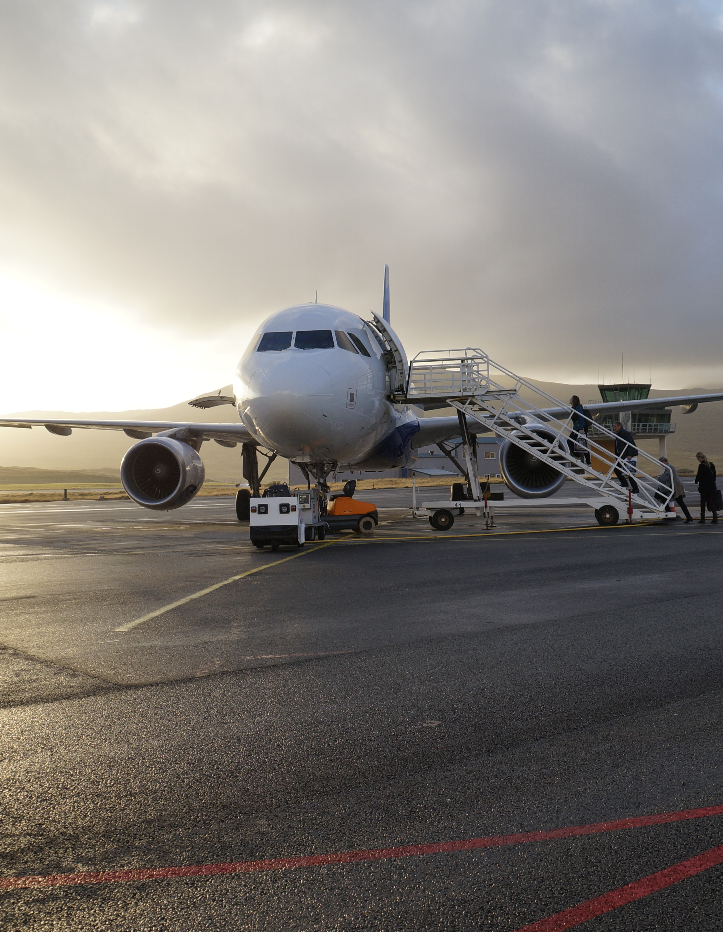
What’s next?
Customer Feedback: Collect customer feedback on non-completed bookings to understand barriers.
Seasonal Trend Analysis: Analyse booking trends by season to identify opportunities for targeted marketing campaigns.
Route-Specific Optimization: Drill down into specific routes to identify those with low completion rates and optimize scheduling or pricing for those routes.

Slide 16

conclusion
By implementing these recommendations, the airline can significantly improve its booking completion rate, optimize flight schedules, and better engage with mobile customers.
These changes can lead to improved operational efficiency and increased customer satisfaction.

Slide 17
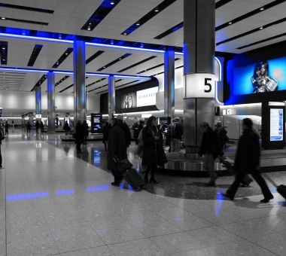
Thank You
Anthony Ofordum​
www.linkedin.com/in/anthony-ofordum/
Than

